Slide 1

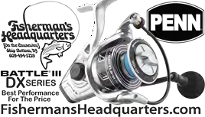

U.S. FIRST CLASS MAIL POSTAGE PAID
TOMS RIVER NJ PERMIT NO. 48
JERSEY COAST ANGLERS ASSOCIATION
1594 Lakewood Rd. (Rt. 9), Ste. 13, Toms River, NJ 08755
Phone 732-506-6565 Fax 732-506-6975
Web Site http://www.JCAA.org Follow us on Facebook
June 2023
FIRST CLASS MAIL
DATED MATERIAL
$31,000 Boat Motor Trailer Package Door Prize for the
27th JCAA Fluke Tournament
JCAA Annual Fluke Tournament
Saturday June 17
Jersey Coast Shark Anglers 2023 Tournament Schedule
Bluefin Fever - June 3-4 Kids Fishing Fever - July 21 Thresher Fever - TBD Fluke Tournament - TBD Month-Long Fluke Tournament Veterans - TBD Tournament - TBD Fall Striper Tournament - TBD For information go to www.jcsa.org
Forked River Tuna Club 2023 Tournament Schedule
White Perch Tournament - April 15 Sea Bass Tournament - May 20, 21 Ladies Catch of the Day - July 8 Tuna Tournament - July 15, 16 Fluke Tournament - August 12, 13 Mark Your Calendar
(p) 201.836.2100 x2118
(c) 201.446.9047
(f) 201.227.5026
363 Cedar Lane Teaneck, NJ 07666
sandel@otterstedt.com www.otterstedt.com
Charles (Chuck) Santoro Insurance Specialist

Slide 2


$500+ JCAA SPONSORS
Full Business Card AD
Chuck Santoro Fisherman Headquarters Fish Hawks
Forked River Tuna Club
Greater Point Pleasant Charter Boat Association HI-MAR Striper Club
Janice and Joe Blaze
Jersey Coast Shark Anglers
$250+ JCAA SPONSORS
Half Business Card AD
Beach Haven Charter Fishing Association New Jersey Beach Buggy Association Raritan Bay Anglers Club
$50 JCAA Sponsors
Asbury Park Fishing Club, Asbury Park, NJ 732-988-0121 Association of Surf Angling Clubs www.asaconline.org Barnegat Fishin' Hole <www.BarnegatFishinHole.com> Howard Beeferman, Monroe, NJ
Belmar Fishing Club, P.O. Box 38, Belmar 07719 Michael Blonske Morrisville, Pa.
Bradley Beach Surf Casters Inc., Neptune, NJ
Vito F. Cardinale, Red Bank, NJ Michael Colucci, Brick, NJ
Jim Davis, Port Monmouth, NJ Daniel DeChurch, Moorestown, NJ
David Dowd, Orange, NJ
William M. Feinberg, Ocean City, NJ
Exton Window Cleaning & Exton Building Maintenance, Exton, Pa. Fortescue Captains & Boat Owners Assn., Inc., NJ
F.U.B Divers, Neptune, NJ Dr. Joel Gelbman
The Geld Family, Elkins Park, PA
Jean A. Hasslinger, In Memory of Ed Anderson
Lagoon View Yacht Club, Waretown, NJ lagoonviewyachtclub.org Bob Lick, Cheyenne, Wy.
In Memory of Joe Kunz, Donated by David Strom & Laura Greenwald
Bruce Halstater, Norwood, NJ
James Krauss, Atlantic Highlands Richard Lippo Mount Laurel, NJ Wilson L Mathis, Barrington, NJ Randy Minix, Gibbstown, NJ Picatinny Saltwater Sportsman Club
Pt. Pleasant Fishing Club, email rmazz1428@gmail.com Newark Bait & Flycasting Club
New Jersey Beach Buggy Association
Round Valley Trout Association, Lebanon, NJ Saltwater Anglers of Bergen County Louis Schott, Galloway Twp.
Schuyler Tuna Fishing Club
Seaside Heights Fishing Club Richard Secare West NY
Shore Aquatic Club, Sea Girt, NJ
Silverton Fishing Club, Inc. Toms River, NJ
David Strom, Jr., West Orange, NJ South Jersey Saltwater Anglers Surf Kings Fishing Club
Douglas Vitale In Memory of Bruce Vitale
Women's Surf Fishing Club of NJ, www.wsfcnj.org
$100+ JCAA SPONSORS
Fishing & Diving Clubs in Bold Type Bayshore Anglers Assoc., P.O. Box, 94, Middletown, NJ
Berkeley Striper Club
Betty & Nick's Bait & Tackle, Seaside Park, NJ, 732 793-2708
Bi-State Shad Fishing Contest, eric@shadfishingcontest.com 610-762-0440
Jon Brunetti, Lakewood, NJ
Delaware River Shad Fishermens ASSN, Allentown, Pa., Harold Dill, Bricktown, NJ www.drsfa.org Bill Dolan, Waretown, NJ
Len Fantasia, Wave Dancer, Atlantic Highlands, NJ
Fins on Feathers Charters, Capt. Frank Tenore, 973 763-2876 Fishin' Physicians
Bruce Freeman, Lavallette, NJ
John J. Gilchrist Architect PC Montvale, NJ
Mark Goehring, Indian Mills, NJ
In Memory of Betty Henze, Lafayette Hill, PA
In Memory of Tom Ortman. A great fisherman, a great guy! In Memory of Randy Minix , Gibbstown, NJ
Hudson River Fisherman's Association, Cresskill, NJ
L Raymond Humphreys, Jr., Pennsville, NJ
Greg & Linda Jewell, Freehold, NJ Long Beach Island Fishing Club Harvey Yenkinson, West Chester, Pa
Capt. Frank Tenore, Fins on Feathers Charters Leonardo State Marina
Manasquan River Marlin &Tuna Club Manasquan Fishing Club
Ocean Beach Volunteer Fire CO 3 behalf of William "Bronco" Bell Paul Olsen, Lanoka Harbor, NJ
Raymond Onofrio, Voorhees, NJ Joseph Palumbo, West Orange, NJ
Todd Piasecki, Little Falls, NJ
Michael Revesz, SW-Life Science Lab Equipment, 877-737-3211 Russell Samano, Millville, NJ
Richard Savacool, Lavallette, NJ Paul Shafer, Bethel, Connecticut George S. Smith Jr., Morganville, NJ Phil Simon, Skillman, NJ
South West Science, Roebling, NJ
Sunshine Organization, In Memory of Randy Minix
Village Harbour Fishing Club, Manahawkin, NJ
In Memory of Bruce Wagner
West Orange Anglers, West Orange, NJ, 793-669-6799
A Saltwater Anglers Club
New Members Welcome
Go to www.FISHHAWKSNJ.com
Meetings are at 7:30 PM on the first Thursday of the month at the Lacey Elks, Forked River, NJ
New Jersey Beach Buggy Association P. O. Box 511, Seaside Park, NJ 08752 BUGGY Membership Info: Ken Hollins 732-814- 7021 www.NJBBA.org Fighting for Beach Access & Conservation Since 1954
Raritan Bay Anglers Club PO Box 546 Perth Amboy, NJ 08862-0546 Membership Info: Don Beyer 908-494-0980 www.raritanbayanglersfishingclub.com

Slide 3
JCAA NEWSPAPER JUNE 2023
Official Newspaper of the JERSEY COAST ANGLERS ASSOCIATION
(Published on May 29th, 2023)
Monthly Meeting Via Zoom Meeting Until Further Notice
"WORKING FOR MARINE RECREATIONAL ANGLERS"
JCAA REGULAR MEETING
May 30th, 2023 Hybrid Meeting
Starting at 7:30 PM
NEXT JCAA BOARD MEETING
Thursday, June 8th Via Zoom Meeting
IMPORTANT DATES
May 30th JCAA General Meeting Jun 6^{th—}8th MAFMC Meeting June 8th JCAA Board Meeting
June 17th JCAA Fluke Tournament
June 23rd JCAA Fluke Tournament Awards Ceremony
June 27th JCAA General Meeting
No JCAA General Meetings in July and August
July 13th JCAA Board Meeting/High Roller Raffle Drawing
July 31^{st —}August 3rd ASMFC Summer Meeting
August 3^{rd—}6th JCAA Heavy Hitters Tournament August 8^{th—}11th Joint ASMFC & MAFMC Meeting August 10th JCAA Board Meeting
November 11th JCAA Dinner
OFFICIAL NEWSPAPER OF THE JERSEY COAST ANGLERS ASSOC.
1594 Lakewood Road (Rt. 9), Victoria Plaza Ste. 13
Toms River, NJ 08755
Phone 732-506-6565 Fax 732-506-6975
JCAA Newspaper Publisher Tom Fote JCAA Newspaper Editor Paul Turi
This publication is printed and mailed one week prior to each regular monthly meeting of the Jersey Coast Anglers Association. One of the prime goals of JCAA is to get accurate information into public hands as soon as possible.
Anyone wishing to reproduce any part of this newsletter has the permission of the JCAA and the authors. Wherever possible, please credit the JCAA Newsletter as your information source.
~~~~~~~~~~~~~~~~~~~~~~~~
JCAA General Membership Meetings are for club representatives and invited guests only. These meetings are not open to the general public. If you would like to attend as a guest, call the President at 908-913-0551 or Tom Fote at (732) 270-9102 before the meeting date to ask permission.
~~~~~~~~~~~~~~~~~~~~~~~~
2022 OFFICERS
27th Annual JCAA Fluke Tournament
$31,000 Boat, Motor & Trailer Door Prize
By Tom Fote
This year the JCAA 27th Annual Fluke Tournament will be held on Saturday, June 17th. The Awards Presentations will be held on Friday night, June 23rd at the Resorts Casino/Hotel. The big news is that we are back to the old days. We are back at Atlantic City at Resorts Casino Hotel on a Friday night for an awards ceremony. When we started this tournament, I suggested that we make the Grand Prize a door prize so a person that could not catch a prize-winning fish could win the Grand Prize. The Grand Prize (Door Prize) is a
$31,000 Boat/Motor/Trailer Package. The $ 27,000 16ft Godfrey Pontoon Boat & LoadRite Trailer was donated by New Jersey Outboards and the 25 HP Outboard was donated by Yamaha. Last year we only had 97 boats that entered the tournament. Of those 97
President 1st V.P.
2nd V.P.
Treasurer Rec. Sec. Cors. Sec. Mem. Sec.
Mark Taylor
Greg Kucharewski Don Marantz Doug Tegeder
732-245-9445
732-429-9637
908-347-1434
732-575-2661
John Toth 732-656-0139
Committee and Chairpersons listed on last page
1

Slide 4
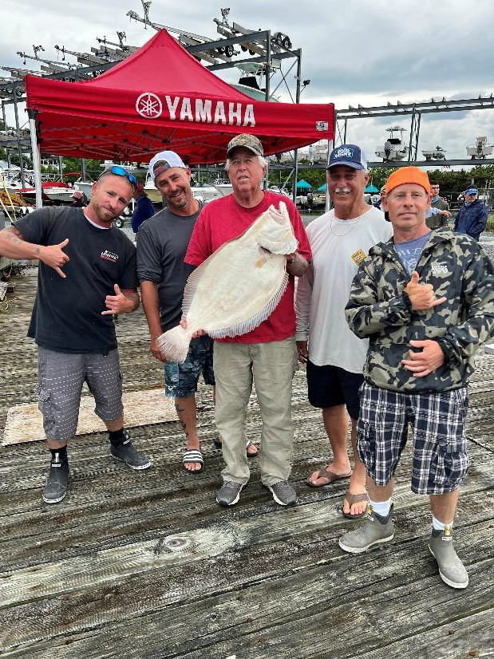
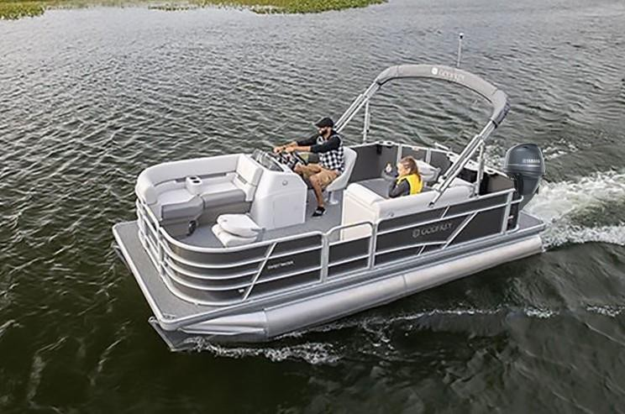
boats last year they had a 1 in 97 chance of winning last year's boat package. This year's package for the same
$150 entry fee, you can walk away with a boat package worth more than twice last year’s. Those are odds better than any lottery out there. I know in past years some people entered the tournament just for the door prizes and the chance to walk away with the boat package.
where it says, “Click here for secure on-line Entry Form.” That will bring you to our Eventbrite site where you can enter. Sometime after entering, we will send you a confirmation email with your tournament entry number and Calcutta options.
The tournament will follow the same format as in previous years, with 7 regions and 7 prizes for each region. We will have ten weigh-in stations from Jersey City to Sandy Hook. In addition to the $50 / $100 Region Calcuttas, $50 / $100 Overall Fluke Calcuttas, we will also be having an optional $50 / $100 Overall Seabass Calcuttas. We will also be offering a Doormat Fluke Category cash prize for the largest fish over 12lbs worth $50,000. We are looking for a repeat of our 2022 winner, Ted Gaydos of Monroe Township and his crew that landed a 12.45 lb. fluke and weighed it in at Gateway Marina in Sandy Hook. Ted also entered all calcuttas, and with that fish swept both $50 / $100 Sandy Hook Region Calcuttas along with both $50 /
$100 Overall Calcuttas in the tournament which earned a total of just over $57,000 for his outstanding catch. The big question is, will your boat be this year’s Ted walking away with close to $60,000?
Resorts Casino/Hotel will be hosting our Awards Presentations on Friday night, June 23rd. Resorts will also be offering as a region prize a one- night stay in their hotel along with $40 in food. Also,
upon registering each registrant will receive either $25 match play or $10 slot play and one free drink at the bar.
The best and easiest way to register is by registering through Eventbrite by going to our website jcaa.org. Click the blue banner at the top of the page
The Jersey Coast Anglers Association is a charitable non-profit 501(c)3 organization that was formed in 1981. The original objective of the JCAA, that continues today, was to combine a group of marine sportfishing clubs to form and promote a united consensus on issues relevant to saltwater anglers in New Jersey. JCAA works to protect the rights of New Jersey's recreational anglers, by seeking fair and equitable fisheries management. It fosters conservation and education while seeking to do what is best for our fisheries to ensure they will be sustainable for future generations. JCAA also strives to create increased angling opportunities and better public access. Further, it is involved with issues concerning our marine environment, such as fighting for better fisheries habitat, keeping our waters clean, and protecting our

Slide 5
forage species while supporting an ecosystem-based management approach. JCAA works in concert with New Jersey's legislature, many major local, state, and national organizations, congress, and federal agencies to advance its objectives.
Gaydos, weighed in at Gateway Marina in the Highlands, make sure you check that box on the entry form and an additional $25 fee. There will be calcuttas to enter as well. Read more on the website, last month’s newsletter as well as this one. There are a lot of fish being caught currently. Hope you enter and see you at the Awards Ceremony on Friday June 23rd at the beautiful Resorts Casino Hotel in Atlantic City. I would like to thank all our sponsors and those that entered.
Remember to get a book or two for our 2023 JCAA High Roller Raffle. This is one of the JCAA fundraisers that Paul Haertel put the prize list together. If you would like to get tickets, please reach out to us at 732-506-6565. Leave your name and a number that you can be reach at, so arrangements can be made.
It’s not too early to mark your calendar for the JCAA Sportsperson of the Year Dinner which will be held on November 11th at the Captains Inn in Forked River. Clubs need to start thinking of someone and put a summary together of 250 –300 words, why that nominee has been selected by your club. The club will vote who they think is the best nominee and submit by email to Paul Haertel at anglerpmh@aol.com also copy me at mtsport64@aol.com. I would like to have all the nominee’s summaries submitted in July and August so they will be published in the newsletters. This will give the other clubs time to look over all nominees and vote for their club who they would support. I will call for a vote by the Club Representatives at the September JCAA Meeting. The votes will be tallied, and the recipient will be selected for JCAA Sportsperson of the Year. JCAA has a Youth Education Award that is honored that night also. To submit this nominee, a summary needs to be emailed to Greg Kucharewski at gkucharews@aol.com.
Membership Chairman John Toth has been doing a great job scheduling for JCAA to do a presentation at clubs. I would like to thank the clubs that scheduled or are planning to do so in future months. If your club would like to have JCAA come, please reach out to John Toth at 732-656-0139 or tothjohn@verizon.net. I have been with John most if not all and have met some extraordinary people.
I would like to see more energy driven individuals getting involved in JCAA. If you are one of those people or would like to get involved with JCAA the time is now. You can start by being involved with one of our committees or become an officer, let me know. I will answer all your questions and help you
President’s Report
By Mark Taylor
As President there are a lot of individuals that reach out to me asking all types of questions on a variety of topics and issues that could potentially affect the recreational community. Questions are good because you get to hear others’ concerns. I always say to individuals, where did you hear about it and did you try to do some research to prove it true or evidence to it. Most times it’s someone else’s opinion on some topic and they normally don’t do any research of their own. We all hear people saying all types of stuff on anything from regulations, environmental and conservation issues. These are all important topics with issues that affect the sport we all love to enjoy now and would like to protect for the future. I take all questions asked very seriously. If I can answer them with accurate information I do so, but if I don’t know the facts I will not. I ask for their information so I can verify their concerns and get back to them. There is a very hot topic right now that is on the forefront of everybody’s mind, that is renewable energy specifically with wind turbines. I believe that every question should be asked and answered with the best proven information possible at that time. I have written an article in this newsletter that may help with that called, “Wind Turbines Questions and Concerns.” The JCAA Annual Fluke Tournament is coming up fast. It is set for Saturday June 17th. Check out our webpage for all the information, rules and entry application forms. We prefer that the entries be done electronically though our webpage. We are trying to streamline the process and use less paper. If you are unable to enter electronically, you can still mail or fax your entry form. Just make sure you fill it out and doublecheck everything you want to get into is correct before sending it in. This year’s tournament will, once again, have a $50,000 prize for the largest fluke weighing over twelve (12) pounds that day. If you want a chance to win that as it was won last year by Ted

Slide 6
with every level of involvement. Contact me by calling 732-245-9445 or emailing mtsport64@aol.com.
We all need to get involved and unite so the future of recreational fishing as we know it will be gone.
5. Hatteras Outfitters 7’ Custom Power Stick CP1020S/FinNor Ahab 12 Spinning Reel – $350, Donated by JCAA
6. Shimano Tallus 7’ TLC70M Conv. Rod/Montauk Cerebus CER210 – $233, Donated by JCAA
JCAA Hi-Roller Raffle
By Paul Haertel
Note: No substitution of the offered prize may be made and no cash will be given in lieu of the prize.
Once again, this year we will be having our Hi-Roller Raffle and as you can see there are some really nice prizes. This is one of our major fundraisers so please buy some tickets. If you buy tickets, I absolutely guarantee you will have a chance to win. If you want tickets call the office at 732-506-6565 or email jcaa@jcaa.org. The prizes listed below have a total value of $3003.
Fisheries Management & Legislative Report
By Tom Fote
Striped Bass
After I left the Commission meeting and reflected on all the craziness that took place, I anticipated writing a long article about striped bass and the needlessly restrictive rules we put in place. Because of a fall and still recuperating, I decided to look at previous articles. I have included an article from March 2019 JCAA Newspaper that was written before the Amendment that put in the 28 – 35-inch size limit. The one thing I will say is that JCAA and some other groups in New Jersey thought the 28 – 35-inch size limit was not good because it targeted the year class we were trying to protect. But the Commission ignored NJ’s comments and put in the slot limit of 28 – 35-inch size limit. Now they say this size limit is targeting the 2015-year class, exactly what we told them in the first place. If you look at all the charts and graphs from the stock assessment, you will understand that the spawning stock biomass is big enough to produce a 2015-year class again, or an even bigger one. The problem is not the spawning
New Jersey Amin. Code § 13:47-8.7
Location:
At the JCAA office located at:
1594 Lakewood Rd., Unit 13, Toms River, NJ 08755
Drawing Date: July 13, 2023, at 7:30 pm
NJLGCCCC Identification: #475-4-32152
Municipal Raffle License: #9471
Beneficiary: Jersey Coast Anglers Association
Price of Ticket: $2 each, 3 for $5, or a book of 7 for
$10
List of Prizes & Retail Values
1. Jersey Nutz Six Man Charter (6-hour, 6-man inshore weekday charter) – $1100, Donated by Captains Robert and Cody Melton
stock biomass. The problem is Chesapeake Bay.
2. $500 Gift Certificate from Fisherman’s Headquarters – $500, Donated by Fisherman’s Headquarters
Global warming is raising the constant water temperature in Chesapeake Bay. Virginia stocked blue
catfish in the rivers. Those catfish are now in the Chesapeake, and they grow to 95 pounds. They eat what would normally be the diet for the striped bass. Not only that but they eat a lot of striped bass fry. I will write another article before the addendum comes out and post it on our website. Some people have said, “Why don’t you look at the science?” But that is exactly what I have done. The Technical Committee,
3. Shimano Talavera 7’ TEC70HC Boat Rod/Canyon Conv. Reel – $420, Donated by JCAA
4. Daiwa Saltiga 6/6” SA66MFB Boat Rod/Canyon HS15L Conv. Reel – $400, Donated by Grumpys Tackle and JCAA

Slide 7
in their guidance for this emergency action, did not support going to emergency action. It is a shame that people on an agenda can bypass the entire process by declaring an emergency. There was no advisor input. They did not ask the public. And they did not ask the people who would be drastically impacted. But they did listen to the people who only want catch-and- release, which we know causes the highest mortality in the fishery right now.
which complicated the stock assessment and management in the region. Since 2016, Congress has annually instructed NOAA Fisheries to fund this survey to provide a consistent time series. A healthy Delaware Bay population supports the economically and ecologically important birding, fishing, and biomedical communities. The continuation of this yearly data is due in a large part to Miranda’s efforts.
In addition to these efforts, Miranda’s in-depth knowledge of coastal and marine issues, including commercial and recreational fisheries, marine mammals, and offshore energy development is not only an asset to Representative Pallone and New Jersey constituents, but also to the management of marine resources along the Atlantic coast.
Miranda Peterson
Below is the release about the award that was presented to Miranda Peterson at the ASMFC reception. This
award is well deserved. Congressman Pallone has
always sent his aides to JCAA meetings. He has always taken a extreme interest in the recreational and
commercial fisheries in New Jersey. So it should come as no surprise that he hires aides who are invested in doing the best for the recreational community. Miranda
NOAA Fisheries Seeks Comments on Amendment 23 to the Summer Flounder, Scup, and Black Sea Bass Fishery Management Plan
Comments due June 14
certainly meets that criteria. What many don’t
understand is meeting with the Congressperson is not always the most effective thing you can do. At the top of my list is getting to know the aide that covers my specific topics. Miranda would certainly be at the top of the list for aides who go above and beyond.
NOAA Fisheries is seeking comments on proposed changes to the management of the commercial black sea bass fishery. The proposed changes were developed and approved by the Atlantic States Marine Fisheries Commission’s Summer Flounder, Scup, and Black Sea Bass Management Board (Board) and the Mid-Atlantic Fishery Management Council (Council).
Over the last decade, the distribution of the
black sea bass stock has changed, abundance and biomass have significantly increased, and there have been corresponding changes in fishing effort and behavior. These changes prompted the Council and Board to reconsider several aspects of the commercial black sea bass management program.
Specifically, this proposed rule considers:
Changing the formula used to calculate commercial black sea bass state allocations
Adding the state allocations and state payback provisions to the federal Fishery Management Plan (FMP)
Changing to the federal in-season closure regulations for black sea bass
ASMFC Excellence Award
Miranda Peterson, Legislative Assistant for Representative Frank Pallone
Congressional and Legislative Contributions
As a Legislative Assistant in Representative Frank Pallone’s office, Miranda Peterson has consistently gone above and beyond to help secure funding for the Virginia Tech Mid-Atlantic Horseshoe Crab Trawl Survey. Understanding the importance of the sustainable management of this species, Miranda has worked diligently to help fund this program. In 2023, she secured the signatures of seven U.S. Representatives on a Dear Colleague letter, which was an all-time high in signatories who support funding the survey.
The Virginia Tech Trawl Survey is necessary for the effective and timely management of horseshoe
crabs in the Delaware Bay. The survey has been in operation since 2002, but lost funding for several years

Slide 8
Because black sea bass state quotas are not currently a part of the federal FMP, the Commission has already implemented the new formula to calculate state allocations. These allocations were effective starting January 1, 2022.
Read the proposed rule as published in the Federal Register today. The comment period is open through June 14, 2023. Submit your comments through the e-rulemaking portal.
Questions?
The death and decay of these algal blooms also deprive marine life of oxygen.
According to the lawsuit, the menhaden population decline caused “damage to Virginia waters” that influenced a decline in organization membership, revenue, and the number of programs the organization can support.
Nearly 1 million recreational fishermen in Virginia contribute $1.3 billion in economic output and support almost 10,000 jobs, Zalesak testified.
Fishermen: Contact Mark Grant, Sustainable Fisheries, 978-281-9145
Managing Fishery
VMRC has been tasked with managing the state’s Atlantic Menhaden fishery, preventing overfishing, and practicing conservation based on the “best scientific, economic, biological and sociological information available,” the lawsuit continued.
Every year, the Atlantic Interstate Commission sets the total allowable catch for menhaden for all participating states on the East Coast.
Virginia is allowed to catch about 175,000 metric tons of menhaden per year, or 75% of the total menhaden harvest for the East Coast.
New Jersey has the next highest allowance at just 11% of the total annual menhaden harvest.
Since 2017, the Atlantic Interstate Commission has capped the amount of menhaden that can be caught in the Chesapeake Bay to 51,000 metric tons.
Virginia may set its catch limits lower but cannot exceed those set by the Atlantic Interstate Commission, which increased in 2022.
Media: Contact Andrea Gomez, Regional Office, andrea.gomez@noaa.gov
Fishermen File Menhaden Lawsuit vs.
VMRC
by Stephanie Jackson, Eastern Shore Post May 22, 2023
A group of commercial and recreational fishermen is suing the Virginia Marine Resources Commission for not protecting the Chesapeake Bay’s population of menhaden — the herring-like fish that is a food source for sport fish such as striped bass — from further depletion.
The lawsuit filed May 10 alleges that on April 13, VMRC adopted a regulation that, instead of
reducing the amount of menhaden caught in Virginia, could actually increase the annual catch by 21,000 metric tons.
‘Rubber-Stamped’ Limit
Omega Protein, a Canadian company, operates the East Coast’s last remaining menhaden reduction fishery, which is in the Chesapeake Bay.
The reduction fishery is so named because the menhaden are reduced to make fish meal, oil, and other supplements.
VMRC granted Omega Protein, called the “Industrial Harvester” in the lawsuit, 90% of Virginia’s
annual allowable catch of menhaden, about 158,000 metric tons, which is 21,000 metric tons more than it was permitted to catch last year.
The lawsuit notes that since only 51,000 metric tons of menhaden can be taken from the bay, the
The plaintiff is the Southern Maryland Recreational Fishing Organization, a 501(c)(4)
nonprofit whose members fish in Maryland and Virginia in and near the Chesapeake Bay.
Phil Zalesak, the organization’s president,
stated that over the last decade, the group has noticed a decline in populations of menhaden and the fish including striped bass that feed on menhaden.
The menhaden not only are food for larger fish and birds like ospreys, they are filter feeders that help clean the Chesapeake Bay.
They prefer to eat algae, which can overgrow, forming blooms that block sunlight from marine plants.

Slide 9
remaining 107,000 metric tons of menhaden must be caught elsewhere in Virginia waters.
However, Omega Protein harvests the rest of the menhaden in and near the mouth of the Chesapeake Bay, further depleting the menhaden in the bay and preventing other menhaden from entering the bay and replenishing the menhaden population, the plaintiff contends.
for us to take action. Before we make these decisions, there is important information everyone should have.
My History with Striped Bass
First, my history with striped bass dates to my
childhood. I fished in Brooklyn on piers and
occasionally on a party boat with my father. My real introduction to striped bass fishing was on the beaches of Coney Island. One day I saw an angler who had
The lawsuit argues that VMRC acted
unlawfully when it “rubber-stamped” the Atlantic
caught a striped bass on the jetty fishing overnight. That is when I became passionate about catching a striped bass. My fishing was interrupted when I went into the army in 1966 and didn’t begin again until I was in the hospital at Fort Dix in 1970. While recovering, my therapy was fishing. The first thing I did when I came home from the hospital was a party boat trip with my father fishing for bluefish.
In 1970 my then girlfriend who is now my wife of 44 years took me to Island Beach State Park to surf fish. A family friend introduced me to the Berkeley Striper Club (BSC) and I became a member in 1972. Since I had free time due to my medical retirement from the service, I was asked to start attending meetings on striped bass. I was lucky enough to meet people like Bob Pond who started Atom Lures. He was volunteering his time to go to clubs from Maine to North Carolina explaining that striped bass was in
Interstate Commission’s new menhaden catch limit without considering available scientific data or applying conservation and management practices as required by Virginia statute.
The lawsuit also argues that VMRC acted unlawfully by adopting the regulation in April; the prescribed period to adopt menhaden management regulations is from Oct. 1 to Dec. 31.
The plaintiff is asking the court for relief including: striking the adopted regulation, requiring VMRC to rewrite the regulation in a manner that protects Virginia waters and the Chesapeake Bay,
setting a timeline for VMRC to complete its analysis and enact the new regulation, and awarding the petitioner’s costs and attorneys’ fees.
Striped Bass: Where Are We Headed
By Tom Fote
(Reprinted from March 2019)
trouble. I was not a fluke fisherman, a tautog
fisherman, a black sea bass fisherman. I fished for striped bass and bluefish. In this period of time, there was much discussion about the collapse of the Chesapeake striped bass stocks. In 1983 BSC asked me to represent them at JCAA. From 1983 to 1987 there was an ongoing discussion at JCAA about whether or not to work to make striped bass a no-sale fish in New Jersey alone or work on the coastwide no-sale.
When I became vice-president, after much discussion, JCAA voted to support NJ Senator Lou Bassano’s bill to make striped bass a no-sale fish in New Jersey. It is important to know who was selling fish in NJ at that time. Many of the hard-core striped bass fishermen who belonged to clubs in that era were what we call “pin hookers”. They were selling most of
There will be some interesting decisions made on the management of striped bass in the near future. The reason the regulations will be up for discussion is the most recent benchmark stock assessment. Because of the recent government shutdown, the document we discussed at the winter meeting of ASMFC was not the final version. But the draft document stated that we were exceeding the reference points on where the spawning stocks should be. This is after all the states took a 25% reduction a few years ago. Basically, the stock assessment says that the current regulations are not rebuilding the striped bass stocks to the base year of 1995 and that we are overfished and overfishing is taking place. The striped bass management plan calls
their catch to pay for their fishing passion. New
Jersey’s law was one of the strictest along the coast.
We had one of the highest size limits and we were the only state that had a bag limit on the number of striped bass you could keep. There was no net fishery so it was all hook and line. At that time I was recreationally

Slide 10
fishing almost 200 days a year and bicycling 6000 miles a year. When JCAA voted to support passage of the bill, I took on the responsibility for passage of the bill. I was naïve. I really did not know about state or federal politics. I knew how the management of striped bass and the agencies for their management worked since I started attending meetings for BSC and JCAA. As fishing had been my passion, now getting this bill passed was my passion. JCAA lost 5 of the original founding clubs of JCAA since their members sold fish and they would not support no-sale. I visited almost every club in NJ and began visiting coastwide clubs seeking their support. In the 70’s I actually belonged to Save Our Stripers in NY which was also pursuing no-sale. This battle changed the course of my life. I started going to ASMFC meetings and learned I had no respect for how they were managing striped bass or how the board was controlled. Even as a Governor’s or Legislative Appointee, you were not allowed to sit on a management board. The management board for striped bass had representatives from only 5 states, consisting mainly of the states with a large commercial fishery, NY, Massachusetts, Virginia, Maryland and New Jersey. JCAA started sending me to ASMFC meetings
It is important for me to explain my philosophy for supporting making striped bass a no-sale fish. Striped bass along the coast was mainly a recreational caught fish. Outside of the Chesapeake Bay the commercial market was largely made up of a hook and line fishery. In NJ and Massachusetts, the commercial catch of striped bass was totally a hook and line fishery, mainly made up of recreational anglers selling their catch. People supported striped bass no-sale for different reasons. Some want all fish to be catch and release. Some wanted an abundant fishery for everyone to have the opportunity to land one of the biggest fish from the surf. My feeling was it was the only game fish we could protect that so everyone could harvest, rich or poor. Some of the best striped bass fishermen I know fish with gear that is not expensive. They repaint their plugs and reuse everything and they are some of the best striped bass anglers. Because I grew up fishing on party and charter boats, I realized anglers took home fish to feed their families. I felt that if we eliminated the commercial sale of striped bass there would be enough fish to provide all recreational anglers with a
quality fishery. Recreationally, I have always
to represent our interests. I built friendships with
understood both the catch and release community and
people at the meetings from other states who shared my passion for the protection of striped bass and, in some instances, for making striped bass a no-sale fish.
Three years of my life was spent on the NJ legislation, going to hearings, meeting with politicians and clubs. I’m a fast learner and I had some good teachers. The culmination was in 1991 at a JCAA
meeting at the Jersey Coast Shark Anglers building
the catch-for-dinner community. The overriding factor is that this needs to be a sustainable fishery with large enough numbers that it can be a quality fishery for all sectors. Striped bass has gotten me involved in ocean
dumping, water protection, renewable energy,
endocrine disruptors and many other areas. It has
changed my life as it has for many other anglers.
1995 Regulations
To understand today’s discussion, you need to understand the regulations that were put in place in 1995. I have been at the striped bass board meetings since 1986. At that time the public was not allowed to
when Governor Florio signed the striped bass no-sale bill with Senator Lou Bassano on one side and Assemblyman John Paul Doyle on the other; the bill that people said I could not get passed. When you are in my house you see a copy of the bill, a pen from the signing and a picture from that night prominently displayed. I felt that was my first accomplishment for JCAA and our member clubs. We went from 36 clubs to 100 clubs which included clubs from Maine to North Carolina, all wanting to work on coastwide no-sale. JCAA was so passionate about promoting catch and release that when we started the Governor’s Surfing Tournament we had judges riding the beach so people could catch and release any fish they caught. We only measured the length and that is still how it works 25
ask questions and neither were ASMFC
Commissioners who were not state directors. In 1989
the discussions began about how to re-open the fishery since many of the states along the east coast had a total moratorium on fishing for striped bass but the stocks had begun rebuilding. The 1989-year class was one of the best in striped bass history and pushed the 3-year average high enough to allow for the resumption of the fishery. During the discussions at the striped bass board meeting and with the advice of the technical committee, the board debated all day long about
years later.
whether or not to open the fishery with 2 fish at 24

Slide 11
inches in the Chesapeake Bay and 2 fish at 34 inches along the coast recreationally and with the same size
Most of the people I fished with or knew didn’t like striped bass for dinner and fished for other species for food. There were not as many striper fishermen in general, even fewer who were taking striped bass home to eat. That was part of the big increase in the number of private, party and charter boats targeting striped bass. The 1995 amendment was good based on the era for which it was written. It allowed for a fantastic fishery on big fish throughout the 90’s and into the early 2000’s.
limit commercially with quotas. Before the board
broke at 9:30 PM the audience was asked for comment. I was pushed to speak for the audience and asked the board for an opportunity to speak before the vote the following day. The board agreed and we went to sleep. The next day they opened the meeting at 8:30, made a motion to open the fishery at 18 inches in Chesapeake Bay and 28 inches along the coast. That motion was passed in 45 minutes without public comment. At 1:00 they asked for our comments and I was again the spokesperson. I said, “You don’t give a damn what we have to say but you will in the future.”
Because of that board meeting the community was excited to be more involved and began attending more striped bass meetings. There were no longer 5 or 6 of us in the audience but more often 30 or 40. The ASMFC commissioners began hearing from the recreational anglers and the process began to open. By the time the 1995 amendment was being drafted, the recreational sector along the coast had developed a
The New Fisheries in the 2000’s
Because of the concerns of the MidAtlantic Fisheries Management Council and ASMFC, there was a dramatic change in the way we manage fisheries jointly. We kept raising size limits and shortening seasons and cutting bag limits. Anglers who fished for their tables had fewer opportunities to bring fish home. There were periods of time that striped bass and bluefish were the only fisheries without closed seasons. Anglers discovered they were spending a great deal of time, effort, and money with little to show for it if their target was fluke, black sea bass or tautog. So it was the natural move for many private, party and charter boats moving into the striped fishery, especially since it was open year-round. The abundance allowed for novices to meet with success. All you had to do was snag a bunker and you were a striped bass fisherman. The pressure on the striped bass population resulted in fewer trophy fish being caught. In the 90’s the hook and release mortality rate was greater than the number of fish we were taking home to eat. By the 2000’s we began putting more pressure on the stocks. Because people were taking more fish home to eat and the hook and release mortality increased because more fish were being hooked and released, the stocks actually began to change and there were fewer big fish available. This is the natural progression for a recovered fishery. The question is whether or not this is sustainable.
Hook and release mortality has always played a big role in the striped bass stocks. In 2017 and 2018 the hook and release mortality exceeded the number of fish anglers were taking home to eat. The catch and release fishermen generally turn a deaf ear when we talk about catch and release mortality, denying they contribute to the problem with the stocks. In the late 90’s a friend of mine from NY, one of the leading striped bass conservationists, and I were having a
stronger voice. There were not only ASMFC
commissioners from the states who were speaking at
board meetings. The 1995 amendment was an example of our participation. It was designed to have a quality fishery and the base year was the year that we declared the fishery recovered, the highest point we had seen since we started the striped bass emergency act in the early 80’s. The referent points, unlike other fisheries, were made more precautionary. I was one of the three NJ ASMFC Commissioners making those striped bass management decisions.
In 1995 the participation in the striped bass fishery was different than it is now along the coast. But
so was every other fishery. It is important to
understand what was happening in 1995. We were still benefiting from the large number of big striped bass
that were protected during the moratorium that was in place from the 80’s through the early 90’s. Many of the states had not opened the fishery to 2 fish at 28 inches along the coast and put in seasons that were more conservative than required. There was also a smaller group of anglers. Most striped bass fishermen were like me, we didn’t talk about catching fluke, black sea bass or tautog. Our 24/7 talk was about striped bass fishing. The seasons were open all year for black sea bass, fluke, scup and tautog. Summer flounder had a
10 fish bag at 14-inch size limit and no closed season.
discussion about striped bass management. We were

Slide 12
discussing the two fish bag limit allowed to charter boats in NY. Since he had become a catch and release fisherman after many years of fishing, he thought they should only be allowed a one fish bag limit even though at that time there was no problem with the stock. I suggested he consider the angler who took two fish home. This angler may make 5 trips a year on a charter boat. If the angler is lucky enough, he/she kills 10 fish to take home to eat. The angler probably caught and released a few other fish on those 5 trips. We agreed the angler releases 30 fish on those trips. With 8% mortality, the angler has killed 2.4 fish in his releases for an estimated total of 13 striped bass he/she killed that year. The catch and release angler who was fishing almost every day, lands hundreds of fish in a season. I suggested that once this angler catches 160 fish, he/she should stop because the catch and release mortality is
12.8 fish. Since a dead fish is a dead fish no matter if it is a catch and release or kept fish. The angler on the charter boat is more likely to be using heavier tackle, fishing in the spring and fall when the water is cold and in saltwater. These factors lower the catch and release
than high enough to produce the highest young of the year in Chesapeake Bay. In spite of the skepticism, I received when I said the spawning stock biomass was high enough to produce the highest young of the year when we were discussing the last addendum, the facts proved I was correct. The 2011-year class was the 4th highest in history of the young of the year. The 2015- year class was the 8th highest in the young of the year index in the over 70-year history. The hook and release mortality was going down but has increased in the last few years. It is also a fact that we are never returning to the way the recreational fishery operated in 1995 or
the 2000’s. This is the first benchmark stock
assessment in which we are using the adjusted
recreational catch numbers which show an increase in both catch and participation from the methods we historically used.
There are also things that are affecting fish populations that have nothing to do with fishing pressure. The water quality of the Chesapeake Bay and the warming of the waters inside the bay and elsewhere are just two of them. Then there is added pressure on
the harvest of the forage species that striped bass count
mortality. The higher the water temperature, the
greater the catch and release mortality. The lower the
on. NJ beach replenishment has impacted many
salinity of the water, the greater the hook and release mortality. A study by Maryland showed the higher the air temperature, the greater the hook and release mortality. So the year-round angler probably has a higher hook and release mortality due to the climate issues since he is fishing a lot more. For example, if you are fishing in a river where the water is fresh or brackish, the water temperature is high, the air temperature is high and you are using light tackle, so the fight is longer, the catch and release mortality is extremely high. The studies again prove this is true. Catch and release anglers need to consider these factors before they blame other anglers who take a few fish a year for the table for problems with the stocks. We each need to put ourselves in other’s shoes before we condemn them and put our own homes in order.
species. I can list many more but these are things that we cannot control through fisheries management.
Management Choices
The ASMFC will be focusing its attention on what we do in either a new addendum or amendment. What we decide will have a huge impact on the recreational fishing industry, the anglers and the states. These
decisions should be made thoughtfully and
deliberately. They need to include all stakeholders and
look at the long-term consequences on what we do. All options should be on the table and be discussed with the general public. In the mission statement of ASMFC it states that we are managing fisheries to be sustainable. That means different things to different people. Below I am listing some of the options that are available to us. I have not taken a position on any option at this time since I need more information and a discussion about the long-term impact of each of the options on the fishing community. There are more that may come up for discussion.
Where Are We Now
We have a striped bass fishery that has expanded. Unlike the 90’s striped bass is important to
the party and charter boats. It has also grown
increasingly important to all the private owners who
cannot fish for fluke, tautog or black sea bass in closed seasons or with the increasing size limits. The science
1. Season closures – We could close the fishery when the highest hook and release mortality takes
tells us that the present spawning stock biomass is more
place.

Slide 13
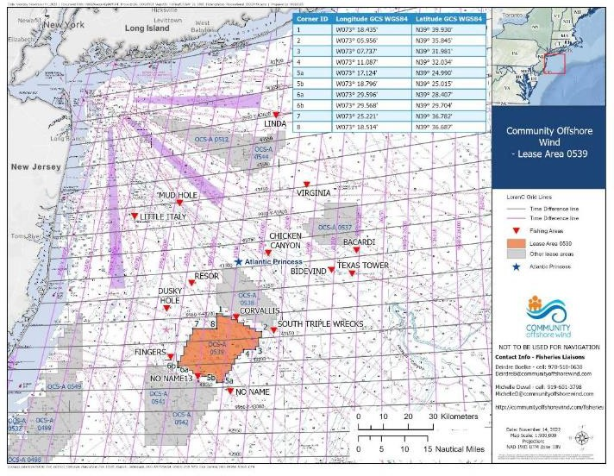
Size limits – We could raise the size limits though that might raise the hook and release mortality as anglers continue to fish until a legal fish is caught.
Education – We could work with anglers to lower the hook and release mortality.
Research on poaching – We need a better handle on the amount of poaching and better law enforcement especially in areas like Raritan Bay and the EEZ.
Changed reference points – This could allow us to continue fishing as we do now since we would identify the stock as sustainable at a lower number.
A combination of options or others now mentioned here
not have thought of, but they need to be answered with current documented facts. Unanswered questions are the best way to get people in a defensive mode with false statements being made. I know there are recreational fishing clubs and individuals that have reached out to several offshore wind groups with questions and have received little or no response. I was invited along with two other JCAA board members to sit down and talk to three individuals with a group called Community Offshore Wind. They were Michelle Duval, Deirdre Boelke who are Fisheries Liaisons for Community Offshore Wind and Rick Robins with RWE. Remember, all these named groups are made up of different companies that specialize in different parts of these projects that come together under one group name. The Community Offshore Wind group is currently in the middle of doing high geophysical surveys on lease area 0539 since December 9, 2022 and expected to be completed August 31, 2023. This lease area is offshore located 32 nautical miles east of Barnegat Inlet, NJ and 56 nautical miles south of Long Beach, NY. To give you a reference that fishermen may know, it is positioned east of the Star Slough and just south of the Corvallis wreck. We had a lengthy discussion about what they are doing to protect the marine environment and the concerns of fishermen. In conclusion of the discussion, they agreed a willingness to help with answering concerns and questions that fishermen may have. That day I had asked a few questions and they did follow up with some answers and are still investigating others. For example, I asked a question about current lubricants used in wind turbines and are there any environmentally safe lubricants being used now or projected in the future. Here was the answer I received from Michelle Duval.
The Impossible Dream
It might be easier to get 10 striped bass together to agree on management issues than to get 10 striped bass fishermen to agree. I am always an optimist and realize that compromise is essential to deal with the needs of many. All of us are going to have to give a little to make this work. No one will be totally satisfied. I haven’t dedicated 40 years of my life to striped bass management to give up now. But I am also not going to manage this fishery for just one sector of the
recreational community. I have not been paid by
anyone or any group in all the years I’ve been doing these many jobs. Since I am a 100% disabled veteran and retired military officer, I did not need to get paid. I always have seen this as continuing my service.
Wind Turbines Questions and Concerns
By Mark Taylor
Wind Turbine is a very hot topic with many recreational fishermen and environmentalists. They have many unanswered questions, opinions, and statements with no proven facts that need to be dealt with. I felt it was my obligation as President of Jersey Coast Anglers Association (JCAA), to try get some way to get these unanswered questions answered by offshore wind groups. All the questions and concerns are great. It keeps all of us thinking of things we may
11

Slide 14
“We wanted to circle back and let you all know that we asked our engineering team about the volume and types of turbine lubricants but are still waiting on some information. Of the currently available turbines with gearboxes, the maximum fluid capacity is ~580 US gallons, while turbines without gearboxes (also known as direct drive) use less fluid. Most manufacturers no longer offer wind turbines with gear boxes. We’re working to get more specific information on the biodegradable nature of the fluids being used in the generation of turbines under consideration or development and are also talking to third-party
County, Bradley Beach Surf Casters, Barrington Rod & Gun Club, Jersey Coast Shark Anglers, Forked River Tuna Club, Manasquan Fishing Club with a $250 Sponsorship, and Sandy Hook Bay Anglers with a $500 Sponsorship, the Bayhead Shore Flyrodders, the Sunrise Rod & Gun Club, the Village Harbor Fishing Club, Beach Haven Marlin & Tuna Club, Staten Island Fishing Club, the Ocean City Marlin & Tuna Club and the Schuyler Tuna & Fishing Club
Please let me know if I have missed your club with a dues payment or if I need to make a correction to your club’s payment.
Both Mark & I visited the Surf Kings Fishing Club at their Sea Girt Lighthouse meeting location to give them our JCAA PowerPoint presentation. Irwin Weinerman, Arthur Phillips, Tom MacMahon and their members made us feel at home and we so much enjoyed our visit with them!
Our JCAA presentation can be customized to fit into your club meeting schedule either by in-person or by ZOOM. We have done it in about 20 minutes or about 45 minutes. We cover a lot of ground starting
with the beginning of the JCAA, what the JCCA has accomplished, what it is working on today and the fishing challenges all of us anglers face in the future. We also take questions and provide answers to them to the best of our ability.
suppliers about biodegradable lubricants. We’ll
definitely follow up, but please let us know if there are other questions that come up that we can try to help
answer. I think this is a great source that you can send your questions to and get answers.”
Send your questions to Michelle and Deirdre plus copy jcaa@jcaa.org so we can make sure there is an answer.
Michelle Duval michelled@communityoffshorewind.com michelle.duval.extern@rwe.com
(919) 601-3798
Deirdre Boelke deirdreb@communityoffshorewind.com deirdre.boelke@rwe.com
(978) 518-0638
To schedule this JCAA PowerPoint
presentation, I need to know the date when your club
has its meeting, the time of it, the address of the meeting location and the contact person to arrange your meeting with me. I have been contacting clubs to schedule this PowerPoint presentation and I would appreciate your getting back to me at your earliest convenience so that I can arrange our meeting with you.
Also, I would like to have updated emails of your club representatives so that we can send you the agendas of our general membership meeting and also contact you on important issues that may quickly come up about our fisheries.
Our next JCAA General Membership meeting is on May 30th, and it will be done both as an in-person meeting and also by ZOOM at the Shark Anglers
building in Herbertsville starting at 7:30 p.m.
The community offshore wind website can be found at communityoffshorewind.com. The Fisheries page is at this link.
JCAA Membership Report
By John Toth
We have received a number of checks for JCAA membership from the: Seaside Heights Fishing Club, the Fish Hawks, Surf Kings Fishing Club, the Beach Buggy Fishing Club (NJBBA) and the Hudson River Fishermen’s Association (HRFA) Bay Head Shores, Delaware River Shad Fishermen’s Association, Newark Bait & Fly Casting Club, Berkley Striper Club, NJ Shark Anglers Club, the Hi-Mar Striper Club with a $500 Sponsorship, Saltwater Anglers of Bergen
I can be contacted at tothjohn@verizon.net or at (732) 656-0139 if you have any questions.

Slide 15

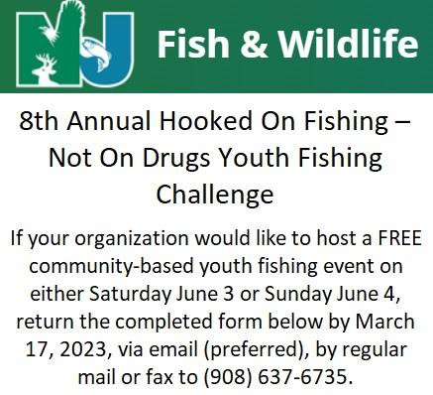

Youth Education Report
By Greg Kucharewski
NJSGC’s “JERSEY SHORE” PHOTO CONTEST
HOFNOD YOUTH FISHING CHALLENGE
The 8th Annual Hooked On Fishing – Not On Drugs Youth Fishing Challenge will be held on the weekend of June 3-4. Find details here on the NJ DEP site. Click here for registration form.
This is a great opportunity for youngsters to experience photographing the beautiful Jersey Shore. If you have a photo that captures some of New Jersey’s beaches enter it in the NJSGC’s revamped “Favorite Beaches of the Jersey Shore” photo contest! Ultimately, the top twelve photos will be used to create New Jersey Sea Grant Consortium’s annual desktop calendars for 2023. Click here for rules and how to submit your photograph.
IGFA & RCE PROVIDE FREE “REEL INTO FISHING”
This is a terrific opportunity for youngsters to learn about fishing. The youth fishing program, "Reel Into Fishing!", is hosted by Rutgers Cooperative Extension (RCE) in partnership with the International Game Fish Association (IGFA) on August 16-18. Learn more about this exciting free program. Contact: Douglas Zemeckis (County Agent III – Assistant Professor) at zemeckis@njaes.rutgers.edu.
REGISTER FOR OPERATION HOOK IT
Last year, MA 22, Operation Hook It, provided 392 Veterans with the opportunity to participate in Operation Hook It for FREE. Veterans fished from shore, jetty, pier, and private/party boats. During the 2023, fishing season boaters & captains will again support our heroes and offer more free boat trips. Eric Chamberlain and Kevin Nolan, and Paul Hewitt encourage our veterans to register and update their information. Click here for info on Operation Hook It and registration link.

Slide 16
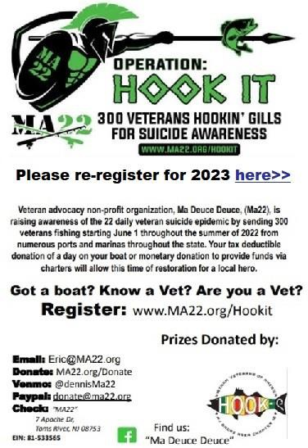
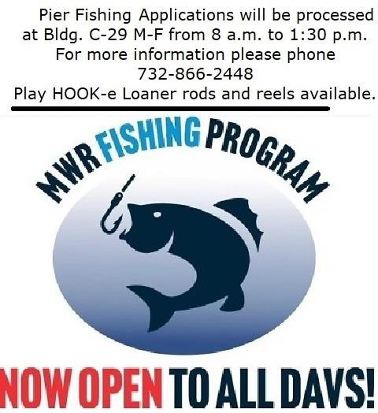
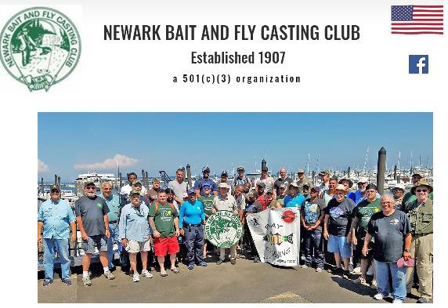
JCAA Veteran Outreach, Play HOOK-e Go Fishing will assist upcoming fishing programs to promote saltwater fishing. We thank our friend Roy H. for all the custom rods and reels he provides for our veterans. This year our selection committee will decide who will receive the custom Vietnam Service Ribbon rod and reel. Bob Hopkins was the recipient last year for his dedication to youth fishing at Camp Happy Times. We also thank Sean Moley and Peter Locke for their contribution of fishing equipment and terminal tackle that will be utilized at NWSE.
NBFCC MI-JO FISHING TRIP
On Friday, June 2nd, Newark Bait and Fly-Casting Club has teamed up with MA 22 and will have a charter fishing trip on the Mi-Jo out of Atlantic Highlands for veterans/disabled veterans. As in the past, Play HOOK-e will supply rod and reel prizes for the event.
Please visit the JCAA Website for updates and don’t forget to register for free with the NJ Saltwater Recreational Registry Program.

Slide 17
Please Support our Sponsors!
Imperium Outfitters – www.imperiumoutfitters.com
Jersey Coast Shark Anglers – Brick, NJ (see on FB)
Key Harbor Marina – www.keyharbormarine.com
Tony Maja – www.tonymajaproducts.com
Viking Eyewear – vikingeyewear@gmail.com
2022 Sponsors List
Grand Prize Sponsors
Starcraft Marine – www.starcraftmarine.com
Yamaha - www.yamahaoutboards.com
Yacht Club Trailers - www.yachtclubtrailers.com
Gold Sponsors ($1000+)
Engel Coolers – www.engelcoolers.com
Fisherman’s Headquarters – fishermansheadquarters.com
Jersey Nutz Sportfishing – jerseynutzsportfishing.com
Liberty Landing Marina – www.libertylandingmarina.com
Pure Fishing – www.purefishing.com
Sea Owl Sportfishing – (see on FB)
South Harbor Marina – 116 Oregon Ave, Waretown, NY (609) 693-3658
Silver Sponsors ($500+)
Aqua Traction of the Mid-Atlantic – www.aquatractionmidatl.com
Playing Hooky – www.playinghooky.com
Bronze Sponsors ($200+)
Creekside Outfitters – www.creeksideoutfittersnj.com
Raffle, Door Prize and Gift Auction Sponsors
Atlantic B&T – www.atlanticbaitandtackle.com
Avon Products – Carol Ridgeway, 609- 607-9702
Bait Mule Gulp Containers – See on FB
Battery Square – www.thebatterysquare.com
Beach Haven Charter Fishing Association – www.bhcfa.net
Betty and Nick’s B&T – www.betty-n- nicks.com
Bob Campi Plugs – see at BSC flea market
Bob’s Bay Marina – www.bobsbaymarina.com
Bob’s Square Deal Hardware – see on FB
Captain Bill’s Landing – see on FB
Captain’s Inn – www.captainsinnnj.com
Captain Crum Jigs and Rigs – Bob Fitzpatrick 609-536-2079
Catch All Tackle – www.catchalltackle.com
Chatter Lures – www.chattterlures.com
Deadly Dogs Custom Plugs – (410)259- 6580

Slide 18
Dock Outfitters – www.thedockoutfitters.com
Fish Hawks – www.fishhawksNJ.com
Fisherman Magazine – www.thefisherman.com
Fishermen’s Den – www.fishbox.tv/Belmar/FishermansDen
Fishermen’s Supply – www.fishermenssupply.com
Forked River Tuna Club – www.forkedrivertunaclub.com
Gambler Fishing – www.Gamblerfishing.net
Geckobrands – www.geckobrands.com
George Kalwa Fine Arts – www.georgekalwa.com
Glitter Plugs by Ron Mucci – ronk@comcast.net RIP Ron
Great Bay Marina – www.greatbaymarina.com
The Grapevine – www.thegrapevinenj.com
Great Bay Marina – see on FB
Grumpy’s B&T – www.Grumpystackle.com
Hi-Mar Striper Club – www.hi-mar.com
Hook House B&T – www.hookhousebaitandtackle.com
Hudson River Fishermen’s Association
– www.hrfa.org
Jim Levison Photo – www.jimlevisonphoto.com
Jim’s Bait and Tackle – www.jimsbaitandtackle.com
JL Photo – www.jimlevisonphoto.com
Johnny’s Tackle – www.johnnyotackle.com

Slide 19
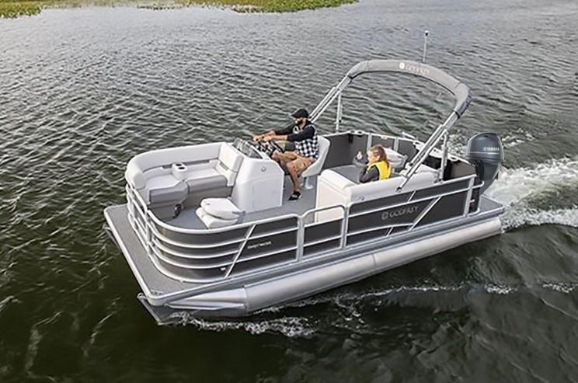

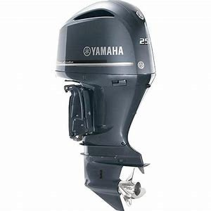

$31,000 Boat Motor Trailer Package Door Prize For the JCAA Fluke Tournament
$ 27,000 16ft Godfrey Pontoon Boat & Trailer
Donated by New Jersey Outboards
105 ATLANTIC CITY BLVD, BAYVILLE, NJ 08721 tel:7325053002
$4,000 25HP Engine Donated by Yamaha

Slide 20
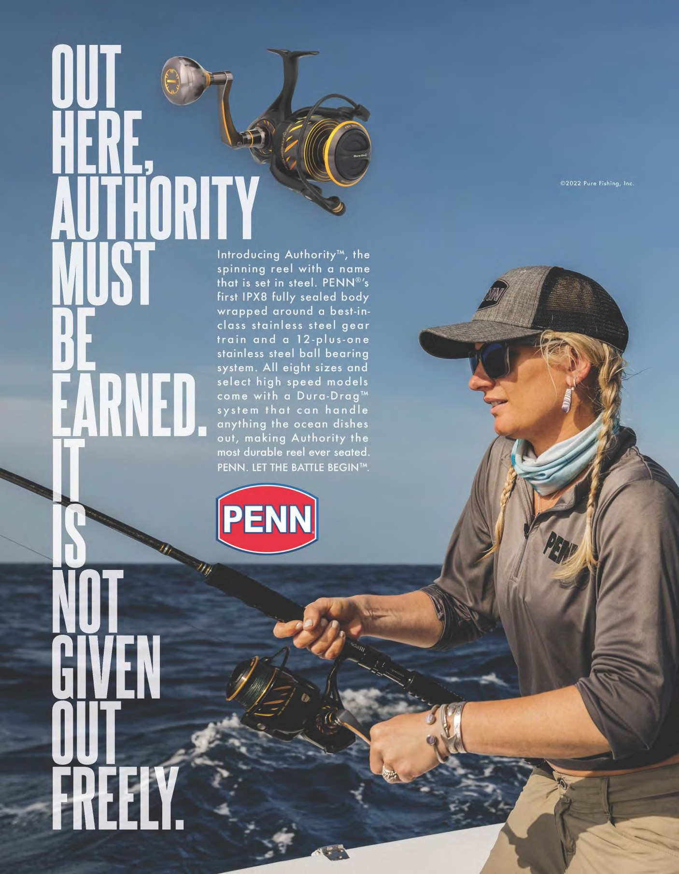
Fluke Tournament Sponsor

Slide 21
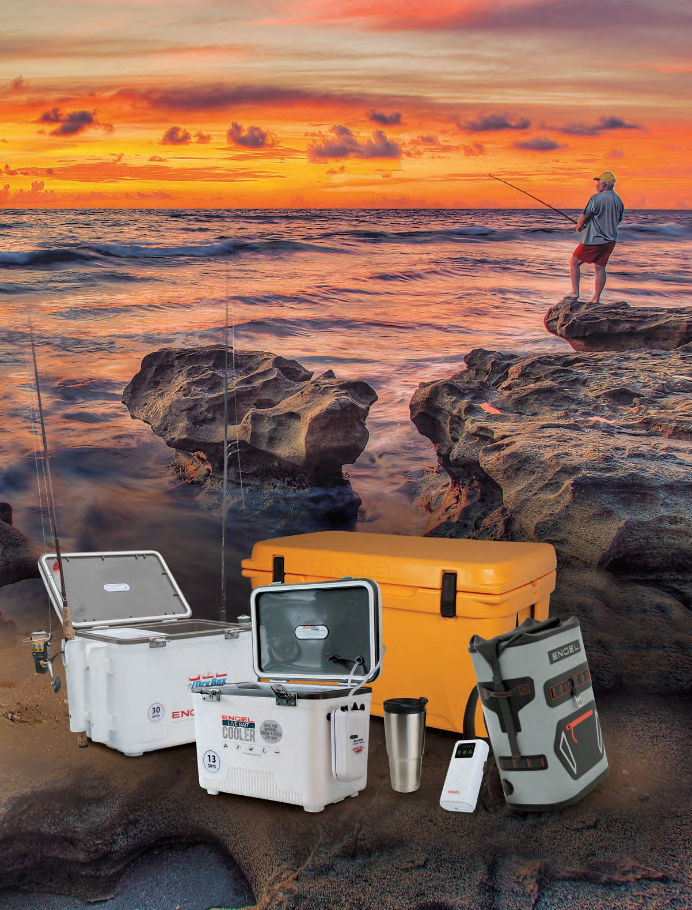


PROUD TO PARTNER WITH
888-272-9838 | ENGELCOOLERS.COM | 900 Jupiter Park Drive | Jupiter, FL 33458 | info@engelcoolers.com

Slide 22
We need the support of your club and its members
Your club should be a member of JCAA and make a difference for only $50 a year. Your club will have a voice in all JCAA positions that affect your fishing future. Your club will re- ceive up-to-date information on vital issues each month.
Club Membership Application
Date
Individuals can join JCAA as an Associate Member
Only $25 per year! Support the Goals of JCAA and receive a subscription to JCAA NEWS that gives you the Most Up-To- Date News about Fisheries Management and Environmental Issues
JERSEY COAST ANGLERS ASSOCIATE MEMBER APPLICATION
Date New Renewal
Name
Club Name:
Street
President's
Name:
City
Pres. Address:
Street
State Zip
City
Email
State Zip
Check if you would rather receive newspaper by email instead of by regular mail. Yes
Ph. #
Ph. #
Fax #
Fax #
COMMITTEES & CHAIRPERSONS
Please make check $50 payable to JCAA
Legislative | Tom Fote | 732-270-9102
Office Manager | Paul Turi | tfote@jcaa.org 732-506-6565
Access: (North) | George Browne | jcaa@jcaa.org 732-674-7060
Access: (South) | George Browne | 732-674-7060
Blackfish | Paul Haertel | 973-943-8201
Blue claw Crab | Bill Browne | 732-504-9344
Blue Fish | Al Marantz | 732-859-0020
Habitat | Paul Eidman | 732-614-3373
Fluke | Paul Haertel | 973-943-8201
Forage Fish | Paul Eidman | 732-614-3373
Highly Migratory Species Eric Engard 609-913-2281 Science & Research Bruce Freeman 732-793-7871
Seabass | Paul Haertel | 973-943-8201
Sponsorship | Frank Richetti | 732-477-3120
Striped Bass | Paul Haertel | 973-943-8201
Ways & Means | Don Marantz | 908-347-1434
JCAA SPONSORSHIP
The JCAA has four levels of sponsorship,
$50, $100, $250 & $500.
Dues paying clubs or individuals can also pro- vide additional help by becoming Sponsors. Sponsors are recognized in our newspaper. For more information call JCAA at 732-506-6565. Become a JCAA sponsor and help our cause. As you can see by our newspaper many of our member clubs are also JCAA sponsors. If your club is not contact us today to become one. With all the new battles we are engaged in, we need to raise more funds in order to be effec- tive. Become a sponsor now and help us to con- tinue the fight.
Webmaster Phil V. Celmer philipc@highlandstech.net
Youth Education Greg Kucharewski 732-840-9197
If you would like to receive JCAA Email alerts email your Name, Club, if you belong to one, and your interest to tfote@jcaa.org or just go to the JCAA Web and subscribe from there.

Slide 23
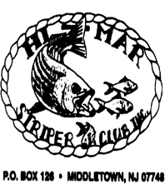




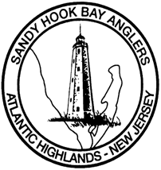
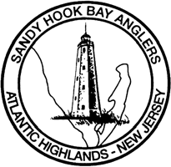

Meetings: 1st Tuesday of month 7:30 PM
Hi-Mar Striper Club 2023 40-Hour
Striped Bass Tournament
Oct 20 - 22, 2023
Friday through
Sunday
Hi-mar.com for info
P. O. Box 126 Middletown, NJ 07748
www.Hi-Mar.com
Jersey Coast Shark Anglers
2014 Tournament Schedule
Striped Bass— May 17th
Mako Fever -June 20, 21, & 22nd
Fluke —August 9th
Blackfish—November 16th
For information call Debbie 732-600-5681
VFW Post 2179
Port Monmouth Middletown Route 36
New Members Welcome
Fish the “Elite Fleet”
Beach Haven Charter Fishing Association
Boats fishing from Beach Haven and Tuckerton, NJ
www.BeachHavenCharterFishing.com
F
ree
41st ANNUAL
2 Day FLUKE TOURNAMENT TBD
33rd ANNUAL
2 Day FLUKE
P.O. Box 513 Atlantic Highlands, NJ 07716 Monthly Meetings Every Second Friday www.SANDYHOOKBAYANGLERS.com
P.O. Box 513 Atlantic Highlands, NJ 07716
Monthly Meetings 2nd Friday of the month at the senior build- ing in Atlantic Highlands (www.sandyhookbayanglers.com)
WE BUILD REEFS
with proceeds from the
“Tuna Mania Tournament” June 10th 11th 12th & 13th Call the Greater Point Pleasant Charter Boat As- soc. to become involved:
732-892-3666
Compliments of Janice & Joe Blaze Brielle, NJ

